Slide 1
Angular 8/9 Unit Testing
Jasmine & Karma

Slide 2
Unit testing plays a very important role when new features are being added in a working functional application, here it reduces the chances of bugs to the rest of the functionality due to the latest change.
What is Jasmine?
Jasmine is a Behavior Driven Development (BDD), open-source testing framework for JavaScript. It aims to run on any JavaScript-enabled platform, to not intrude on the application nor the IDE, and to have easy-to-read syntax. It is heavily influenced by other unit testing frameworks, such as ScrewUnit, JSSpec, JSpec, and RSpec.
Jasmine provides several valuable functions to write tests. Here are the main Jasmine methods:
it(): Declaration of a particular test
describe(): It’s a suite of tests
expect(): Expect some value in true form

Slide 3
What is Karma?
Karma is a simple tool that allows you to execute JavaScript code in multiple real browsers. The main purpose of Karma is to make your test-driven development easy, fast, and fun.
If we talk about the type of functional testing, then there are mainly 3 types of testing:
A. Unit Testing
B. Integration Testing
C. End-to-End Testing

Slide 4
I assume that Node, NPM, and Angular CLI configured properly in your system.
Note: Karma currently works on Node.js 6.x, 8.x, and 10.x.
Latest version:
Jasmine: 3.6.1 [24-07-2020]
Karma: 5.1.1 [28-07-2020]

Slide 5
Let's Get Started
Create a new Angular application.
Create a component using the below command:
ng generate component post-list

Slide 6
Edit post-list.component.ts:
import { Component, OnInit } from '@angular/core';
@Component({
selector: 'app-post-list',
templateUrl: './post-list.component.html',
styleUrls: ['./post-list.component.css']
})
export class PostListComponent implements OnInit {
constructor() { }
userName:String = "Pranam Bhat";
ngOnInit(): void {
}
}

Slide 7
Edit post-list.component.spec.ts:
import { async, ComponentFixture, TestBed } from '@angular/core/testing';
import { PostListComponent } from './post-list.component';
describe('PostListComponent', () => {
let component: PostListComponent;
let fixture: ComponentFixture<PostListComponent>;
beforeEach(async(() => {
TestBed.configureTestingModule({
declarations: [ PostListComponent ]
})
.compileComponents();
}));
beforeEach(() => {
fixture = TestBed.createComponent(PostListComponent);
component = fixture.componentInstance;
fixture.detectChanges();
});

Slide 8
it('should create', () => {
expect(component).toBeTruthy();
});
});
it(`should have a userName 'Pranam Bhat'`, async(() => {
fixture = TestBed.createComponent(PostListComponent);
component = fixture.debugElement.componentInstance;
expect(component.userName).toEqual('Pranam Bhat');
}));

Slide 9
{If you want to download sample code from Git Repository}
Download Angular sample code from GitHub
Git clone https://github.com/PranamBhat/Angular-UnitTesting.git
cd Angular-UnitTesting
npm install
ng test

Slide 10
Execute these commands:
npm uninstall -g @angular/cli
npm cache clean
npm install -g @angular/cli@9.1.0
npm install --save-dev @angular/cli@latest
npm install -g @angular/cli@latest
ng update
ng update @angular/cli @angular/core
ng update @angular/cli @angular/core --allow-dirty –force
ng test
ng test command built the app in watch mode and launches the Karma.

Slide 11
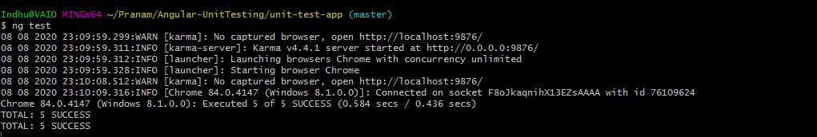

Slide 12
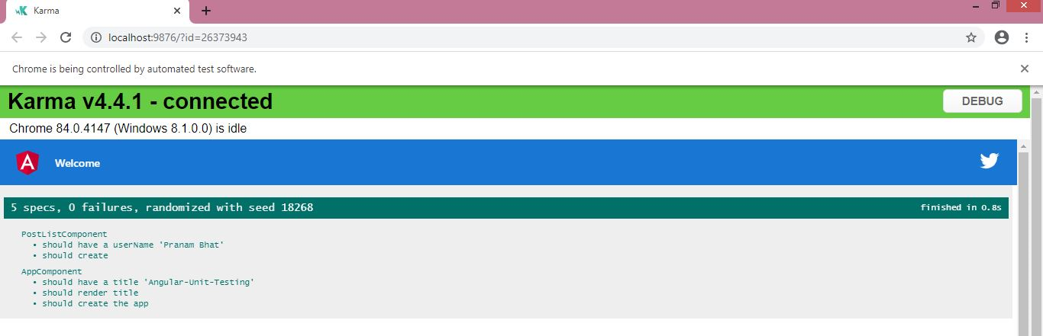

Slide 13
Test Angular Service
We will perform unit test for a service which manages the HTTP requests in Angular application. Create a service with below Angular CLI command:
ng generate service _services/post
This command will create two files:
src/app/_services/post.service.spec.ts
src/app/_services/post.service.ts
We will use here JSON placeholder dummy API of post listing. A method postList() is created to fetch the post listing from the third party server.

Slide 14
post.service.ts:
import { Injectable } from '@angular/core';
import { Observable } from 'rxjs';
import { HttpClient } from '@angular/common/http';
export interface Post {
userId: number;
id: number;
title: string;
body: string;
}
@Injectable({
providedIn: 'root'
})
export class PostService {
API_URL: String = 'https://jsonplaceholder.typicode.com/posts';
constructor(
private http: HttpClient
) { }
postList(): Observable<Post[]> {
return this.http.get<Post[]>(`${this.API_URL}`)
}}

Slide 15
Angular’s new HttpClient has a testing module, HttpClientTestingModule, which makes it easy to unit test HTTP requests.
We are going to write a unit test for the post method crated using the HTTP GET request by taking the help of the HttpTestingController service.

Slide 16
post.service.spec.ts:
import { TestBed, async, inject } from '@angular/core/testing';
import { HttpClientTestingModule, HttpTestingController } from '@angular/common/http/testing';
import { PostService } from './post.service';
describe('PostService', () => {
let service: PostService;
let httpMock: HttpTestingController;
beforeEach(() => {
TestBed.configureTestingModule({
imports: [
HttpClientTestingModule,
],
providers: [
PostService
]
});
service = TestBed.inject(PostService);
httpMock = TestBed.get(HttpTestingController);
});

Slide 17
it('should be created', () => {
expect(service).toBeTruthy();
});
it(`should fetch posts as an Observable`, async(inject([HttpTestingController, PostService],
(httpClient: HttpTestingController, postService: PostService) => {
const postItem = [
{
"userId": 1,
"id": 1,
"title": "sunt aut facere repellat provident occaecati excepturi optio reprehenderit",
"body": "quia et suscipit suscipit recusandae consequuntur expedita et cum reprehenderit molestiae ut ut quas totam nostrum rerum est autem sunt rem eveniet architecto"
},
{
"userId": 1,
"id": 2,
"title": "qui est esse",
"body": "est rerum tempore vitae sequi sint nihil reprehenderit dolor beatae ea dolores neque fugiat blanditiis voluptate porro vel nihil molestiae ut reiciendis qui aperiam non debitis possimus qui neque nisi nulla"
},

Slide 18
{
"userId": 1,
"id": 3,
"title": "ea molestias quasi exercitationem repellat qui ipsa sit aut",
"body": "et iusto sed quo iure voluptatem occaecati omnis eligendi aut ad voluptatem doloribus vel accusantium quis pariatur molestiae porro eius odio et labore et velit aut"
}
];
postService.postList()
.subscribe((posts: any) => {
expect(posts.length).toBe(3);
});
let req = httpMock.expectOne('https://jsonplaceholder.typicode.com/posts');
expect(req.request.method).toBe("GET");
req.flush(postItem);
httpMock.verify();
})));
});

Slide 19
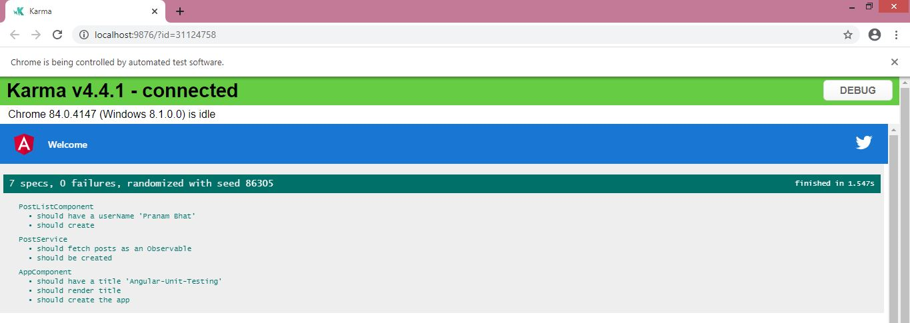
Let’s run ng test command to run the test cases created for Angular service.

Slide 20
Conclusion
In this article, we have learned about how to start writing test cases for Angular Application.
Let me know your thoughts over email pranam707@gmail.com.
I would love to hear them and if you like this article, share it with your friends.

